Slide 1

Aircraft Systems & Instruments
Mr.S.R Arun,AP/Aero
Aeronautical Department
Excel Engineering College

Slide 2
Overview of Aircraft Systems
Major systems overview
Powerplant System – Provides thrust (jet engine or propeller)
Flight Control System – Manages aircraft direction (primary & secondary controls)
Hydraulic System – Powers flaps, brakes, and landing gear
Electrical System – Supplies power to avionics, lighting, and instruments
Fuel System – Stores and delivers fuel to engines
Landing Gear System – Supports takeoff, landing, and ground movement
Environmental Control System (ECS) – Maintains cabin pressure, temperature, and airflow
Avionics Suite – Enables navigation, communication, and flight automation

Slide 3
Importance in flight operation
Safe Takeoff & Landing – Requires coordinated use of gear, brakes, and control surfaces
Navigation & Communication – Enabled by GPS, radios, and autopilot
Situational Awareness – Through cockpit instruments and sensors
System Redundancy – Increases reliability and flight safety
Crew & Passenger Comfort –Pressurization keep cabin habitable
Emergency Management – Systems like fire detection, oxygen, and backup power ensure survivability

Slide 4
Airframe Structure
Wings
Generate lift through their aerodynamic shape
House fuel tanks and landing gear (in some aircraft)
May include control surfaces: ailerons, flaps, spoilers
Fuselage
Main body of the aircraft
Carries crew, passengers, and cargo
Connects all major components: wings, empennage, and landing gear
Empennage (Tail Section)
Provides stability and control
Includes horizontal stabilizer (elevator) and vertical stabilizer (rudder)
Helps maintain flight balance and directional control

Slide 5

Powerplant Systems
Piston Engines
Similar to car engines; used in small aircraft
Operate using internal combustion (spark ignition)
Drive a propeller to generate thrust
Jet Engines (Turbofans)
Common in commercial airliners
Use turbine-driven compressors to accelerate airflow
High efficiency at high speeds and altitudes
Turboprop Engines
Hybrid between piston and jet systems
Jet engine drives a propeller
Ideal for short/medium-haul and low-speed flights

Slide 6
Fuel System
Fuel Tanks:
Store fuel for aircraft propulsion
Typically located in wings or fuselage
Types: Main tanks, auxiliary tanks, surge tanks
Fuel Pumps:
Boost Pumps: Ensure fuel flow during engine start & low-pressure situations
Transfer Pumps: Move fuel between tanks to maintain balance
Engine-Driven Pumps: Provide high-pressure fuel to engines
Fuel Flow Diagram Highlights:
Fuel moves from tanks → pumps → filters → engines
Includes check valves, cross feed lines, and pressure sensors
Ensures redundancy and balance in multi-engine aircraft

Slide 7

Lubrication System
Oil Pumps:
Gear or vane-type pumps used to circulate oil
Provide continuous flow under varying engine speeds
May include scavenge pumps for oil return
Oil Filters:
Remove metal particles and contaminants
Located downstream of the pump
Bypass valves allow flow during filter clogging
Purpose of the Lubrication System:
Reduces friction between moving parts
Cools internal engine components
Cleans and removes debris from engine internals
Seals between piston rings and cylinder walls
Protects against corrosion and wear

Slide 8
Electrical System
🔋 Batteries
Provide initial power to start the aircraft
Serve as emergency power backup
Typically 24V or 28V in small aircraft, higher in large jets
⚡ Alternators / Generators
Supply continuous electrical power during flight
Convert mechanical energy from the engine into electrical energy
Keep batteries charged during operation
🔌 Busbars
Central electrical hubs that distribute power to different systems
Types: essential bus, main bus, avionics bus
Allow isolation of critical systems in case of failure

Slide 9

Hydraulic Systems
What is a Hydraulic System? Uses pressurized fluid to transmit power efficiently for high-load operations.
Actuators
Convert fluid pressure into mechanical movement
Control flight surfaces (e.g., flaps, rudder, ailerons)
Landing Gear
Retracted and deployed using hydraulic actuators
High-pressure fluid ensures smooth and reliable operation
Brakes
Multi-disc brake systems powered hydraulically
Anti-skid systems maintain control during high-speed stops

Slide 10

Pneumatic Systems
What is a Pneumatic System? Uses compressed air (often from engine bleed air) to power essential aircraft functions.
Cabin Pressurization
Maintains comfortable cabin at high altitudes
Uses bleed air regulated through outflow valves
Ensures passenger and crew comfort and safety
De-Icing & Anti-Icing
Pneumatic boots inflate on wing leading edges to break ice
Bleed air can be routed to heat critical surfaces like:
Wings
Engine inlets
Windshields

Slide 11
Landing Gear System
Types
Shock absorbers
Retraction

Slide 12
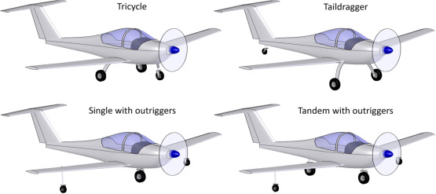
Types

Slide 13
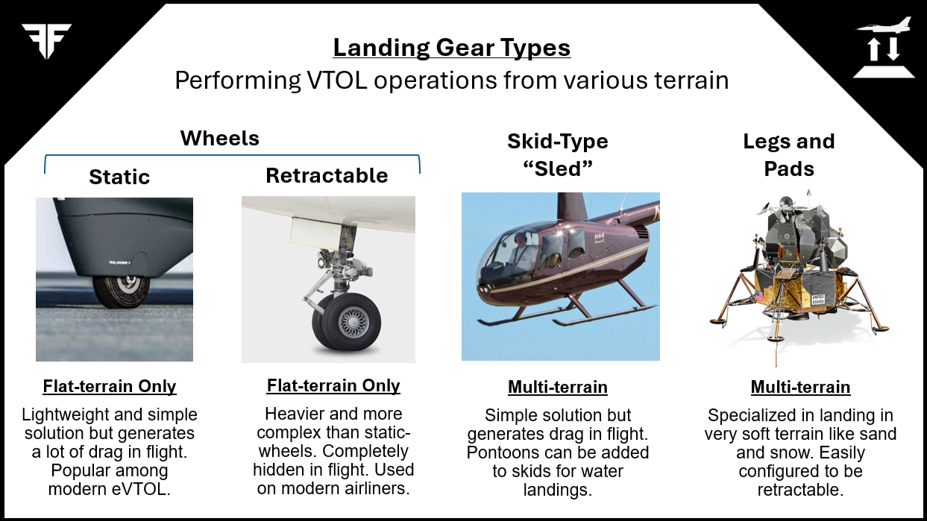

Slide 14
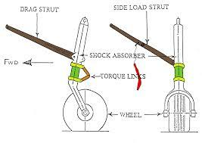
Shock Absorber

Slide 15

Brake Systems
🛠️ Hydraulic Brakes
Most common in commercial and military aircraft
Operate using high-pressure hydraulic fluid
Multi-disc brake assemblies on main landing gear
Integrated with anti-skid systems for safety
Controlled by pilot’s rudder pedals
⚡ Electric Brakes
Emerging in modern aircraft (e.g., Boeing 787)
Use electrically controlled actuators instead of hydraulic fluid
Offer weight savings and reduced maintenance
Provide real-time braking control through sensors

Slide 16
Flight Control Systems
Ailerons
Located on the outer trailing edge of the wings
Control roll (banking left or right)
Move in opposite directions: one up, one down
Elevators
Located on the horizontal stabilizer (tail)
Control pitch (nose up or down)
Both elevators move together
Rudder
Located on the vertical stabilizer (fin)
Controls yaw (nose left or right)
Works with the rudder pedals

Slide 17

Flaps, Slats & Spoilers
Flaps
Located on the trailing edge of wings
Extend downward during takeoff and landing
Increase lift and drag, allowing slower, safer speeds
Slats
Found on the leading edge of wings
Deploy forward to create a gap
Improve airflow at high angles of attack, preventing stall
Spoilers
Flat panels on top of the wings
Disrupt airflow to reduce lift and increase drag
Used for: Speed reduction, Descent control, Lift dump after touchdown

Slide 18

Environmental Control System
Purpose of ECS
Maintains comfortable temperature, pressure, and air quality
Ensures crew and passenger safety at high altitudes
🔧 Key Functions:
Cabin Pressurization Uses bleed air from engines to keep cabin pressure safe
Air Conditioning Cools or heats air via air cycle machines
Ventilation Circulates fresh air throughout the cabin and cockpit
Humidity & Odor Control Filters out contaminants and regulates moisture

Slide 19
Ice and Rain Protection
❄️ Ice Protection Systems
Prevent ice formation on critical surfaces
Key Protected Areas:
Wing leading edges
Engine inlets
Windshield
Pitot tubes
Common Methods:
Thermal (Bleed Air Heating): Hot engine air heats surfaces
Electric Heating: Used for smaller components like sensors
Pneumatic Boots: Rubber boots inflate to crack and shed ice
☔ Rain Protection Systems
Windshield Wipers: Common in smaller aircraft
Hydrophobic Coatings / Rain Repellent Sprays
High-velocity air jets: Used to blow rain off the windshield

Slide 20
Fire Protection Systems
Purpose:
Detect, alert, and extinguish fires in critical aircraft areas
Ensure passenger and crew safety
Fire Detection Systems
Use heat-sensitive loops or sensors
Installed in:
Engines
APU (Auxiliary Power Unit)
Cargo compartments
Lavatories
Trigger warnings on cockpit displays
Fire Suppression Systems
Engine & APU:
Use Halon-based extinguishers
Automatically or manually discharged
Cargo Bay:
Dual-phase Halon discharge (initial knockdown + sustained release)
Lavatories:
Automatic fire bottles in trash bins

Slide 21
Oxygen System
Purpose:
Supplies supplemental oxygen to crew and passengers
Ensures survival at high altitudes during cabin depressurization
Types of Oxygen Systems:
1. Crew Oxygen System
Uses high-pressure cylinders
Delivered via full-face masks
Includes microphones for communication during emergencies
2. Passenger Oxygen System
Chemical oxygen generators activate when masks deploy
Drop-down masks provide oxygen for ~12–20 minutes (time to descend to safe altitude)
3. Portable Oxygen Bottles
Used for medical emergencies or crew mobility
Automatic Activation:
Passenger masks deploy when cabin altitude exceeds ~14,000 ft

Slide 22

Emergency Systems
Purpose:
Ensure safety and survivability during in-flight or ground emergencies
Enable safe evacuation, communication, and system backup
Key Emergency Systems:
1. Emergency Power Systems
Backup electrical sources (batteries, RAT – Ram Air Turbine)
Maintain critical instruments & communication
2. Emergency Lighting
Illuminates cabin, aisles, exits during power loss or evacuation
3. Fire Extinguishers
Located in cockpit, cabin, cargo areas
Halon-based, CO₂, or water-based types
4. Evacuation Systems
Slides and rafts deploy automatically or manually
Doors clearly marked and equipped with emergency handles
5. ELT (Emergency Locator Transmitter)
Sends distress signal to satellites for location tracking after crash

Slide 23
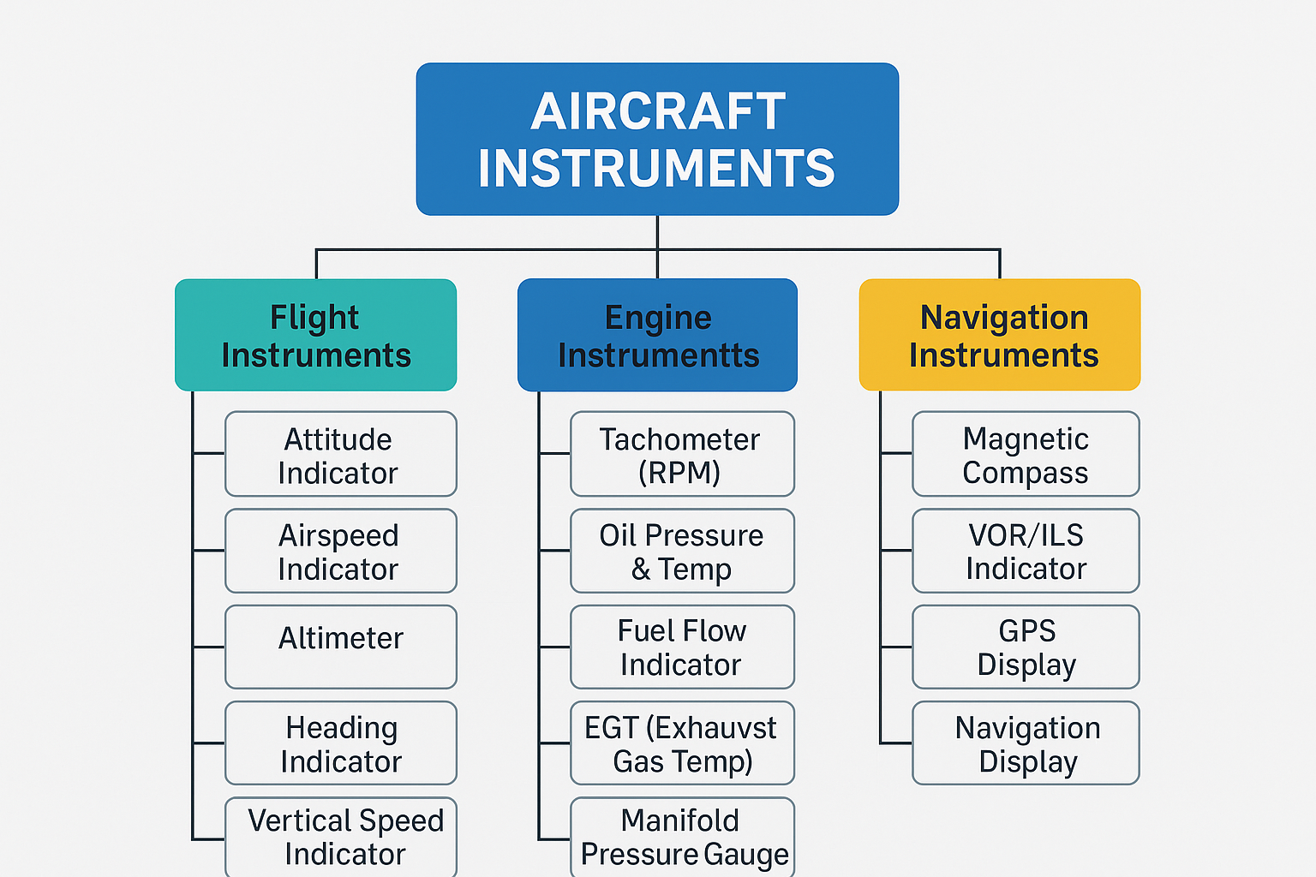
Aircraft Instruments Overview

Slide 24
Flight and Engine Instruments
Primary Flight Instruments:
Airspeed Indicator (ASI): Measures aircraft speed relative to air
Attitude Indicator (AI): Shows aircraft orientation (pitch and bank)
Altimeter: Displays altitude using atmospheric pressure
Heading Indicator (HI): Indicates aircraft direction (uses gyroscope)
Turn Coordinator: Shows rate of turn and coordination
Vertical Speed Indicator (VSI): Displays rate of climb or descent
Navigation Instruments:
Magnetic Compass
VOR Receiver (VHF Omnidirectional Range)
GPS Display (in modern cockpits)
Engine and System Monitoring (Optional to Mention):
Tachometer
Manifold Pressure Gauge
Fuel Quantity Indicators

Slide 25
Communication Instruments
1. VHF Communication Radios:
Primary tool for air-to-ground and air-to-air communication
Operate in the 118.000 – 136.975 MHz range
Typically includes COM1 and COM2 radios for redundancy
2. Audio Control Panel:
Allows selection between multiple radios (COM/NAV)
Adjusts volume and channel monitoring
Enables crew intercom system
3. Transponder (XPDR):
Sends aircraft identity and altitude to radar (ATC)
Modes:
Mode A – Squawk code
Mode C – Altitude reporting
Mode S – Enhanced ID and data link
ADS-B Out – Real-time position broadcast (for modern systems)
4. Emergency Communication:
ELT (Emergency Locator Transmitter): Sends distress signal on 121.5 MHz & 406 MHz
Backup handheld radios in some aircraft

Slide 26

Autopilot Basics
What is Autopilot?
An automatic flight control system that manages aircraft control surfaces
Reduces pilot workload by maintaining steady flight path
Main Functions:
Attitude Hold: Maintains pitch and bank
Heading Hold: Keeps aircraft on a selected heading
Altitude Hold: Maintains a set altitude
Navigation Tracking: Follows a route using GPS or VOR
Approach Mode: Assists in precision landings using ILS
Autopilot Components:
Flight Control Computer: Brain of the system
Servos/Actuators: Move control surfaces
Sensors: Provide attitude, altitude, airspeed, etc.
Autopilot Modes:
Single-Axis (Roll)
Two-Axis (Pitch + Roll)
Three-Axis (Pitch, Roll, Yaw – advanced systems)

Slide 27
Glass Cockpit vs Analog
Glass Cockpit
Digital screens (LCD/LED) showing integrated flight info
Combines multiple instruments into few displays
Easy to read, reduces pilot workload
Displays alerts & data clearly
Higher cost & complexity
Analog Cockpit
Mechanical/electromechanical gauges for each parameter
Separate dials for speed, altitude, attitude, etc.
Simple, reliable, easier to troubleshoot
Slower to interpret multiple instruments
Lower cost & maintenance
Summary: Glass cockpits offer modern, integrated displays for better situational awareness, while analog cockpits provide simplicity and reliability with individual instruments.

Slide 28
Maintenance & Diagnostics Instruments
Maintenance & Diagnostics Instruments
Engine Monitoring Gauges: Track RPM, oil pressure, oil temperature, fuel flow, cylinder head temperature (CHT), exhaust gas temperature (EGT).
Electrical System Instruments: Monitor battery voltage, alternator output, and bus voltage.
Fuel Quantity Gauges: Measure fuel remaining in tanks to avoid fuel starvation.
Warning and Caution Lights: Alert pilots to system malfunctions, low oil pressure, overheating, or electrical faults.
Diagnostic Displays (Glass Cockpit): Integrated systems provide real-time alerts and detailed fault codes.
Data Logging Systems: Record flight and engine parameters for post-flight analysis and predictive maintenance.

Slide 29

Human Factors in Instrument Design
Human Factors in Instrument Design
Readability: Clear fonts, high contrast, and intuitive layouts reduce pilot errors.
Ergonomics: Instruments placed within easy view and reach to minimize head and eye movement.
Information Prioritization: Critical flight data (airspeed, attitude, altitude) displayed prominently.
Consistency: Standardized symbols and colors for easy recognition across different aircraft.
Minimizing Workload: Integration of instruments to reduce scanning and interpretation time.
Alert Systems: Effective visual and auditory alerts to capture pilot attention without causing overload.

Slide 30

Future Trends in Aircraft Systems
Advanced Glass Cockpits: Even more integrated, customizable, and intuitive displays with augmented reality (AR).
Artificial Intelligence (AI): AI-assisted decision support, predictive maintenance, and adaptive autopilot systems.
Enhanced Connectivity: Real-time data link with ground stations, other aircraft, and satellites for better situational awareness.
Fly-by-Wire and Digital Controls: Increased use of electronic control systems replacing mechanical linkages for precision and safety.
Virtual and Mixed Reality Training: Immersive pilot training environments simulating cockpit systems and emergencies.
Eco-friendly Technologies: Systems designed to optimize fuel efficiency and reduce emissions.

Slide 31
Review:
Key Takeaways:
Aircraft instruments are vital for safe and efficient flight.
Glass cockpits offer integrated digital displays; analog cockpits use mechanical gauges.
Maintenance instruments monitor engine and system health.
Human factors in design improve usability and reduce pilot workload.
Future trends focus on AI, connectivity, and immersive training.

Slide 32
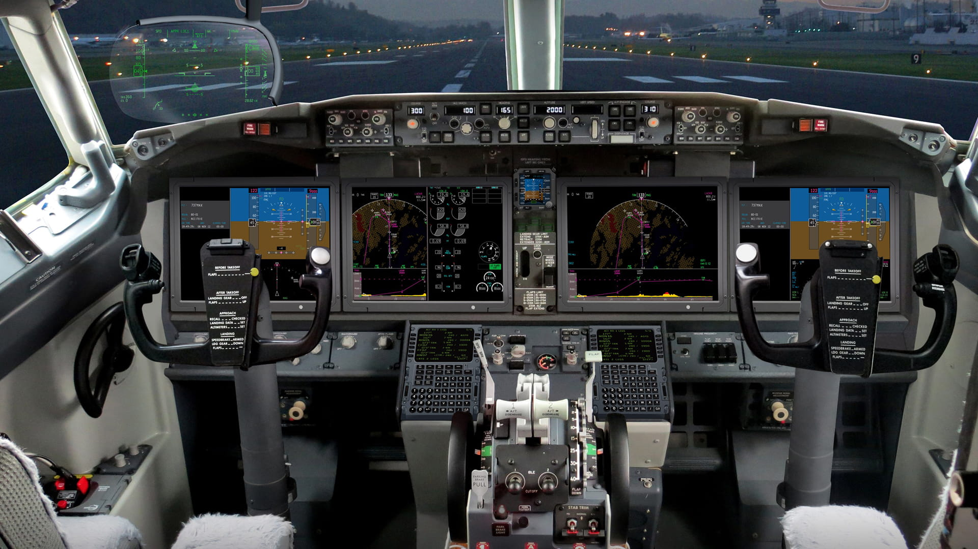
Avionics in Modern Aircraft

Slide 33
What is Avionics?
Avionics is the term used for the electronic systems installed in aircraft, spacecraft, and satellites. It includes all the instruments and devices used for:
Communication: Radios, transponders, data links.
Navigation: GPS, inertial navigation systems, VOR, ADF.
Flight Control: Autopilot systems, fly-by-wire controls.
Monitoring and Diagnostics: Engine instruments, warning systems.
Weather Detection: Radar and other sensors.
Avionics improves safety, efficiency, and situational awareness by providing pilots and crew with essential data and control systems.

Slide 34
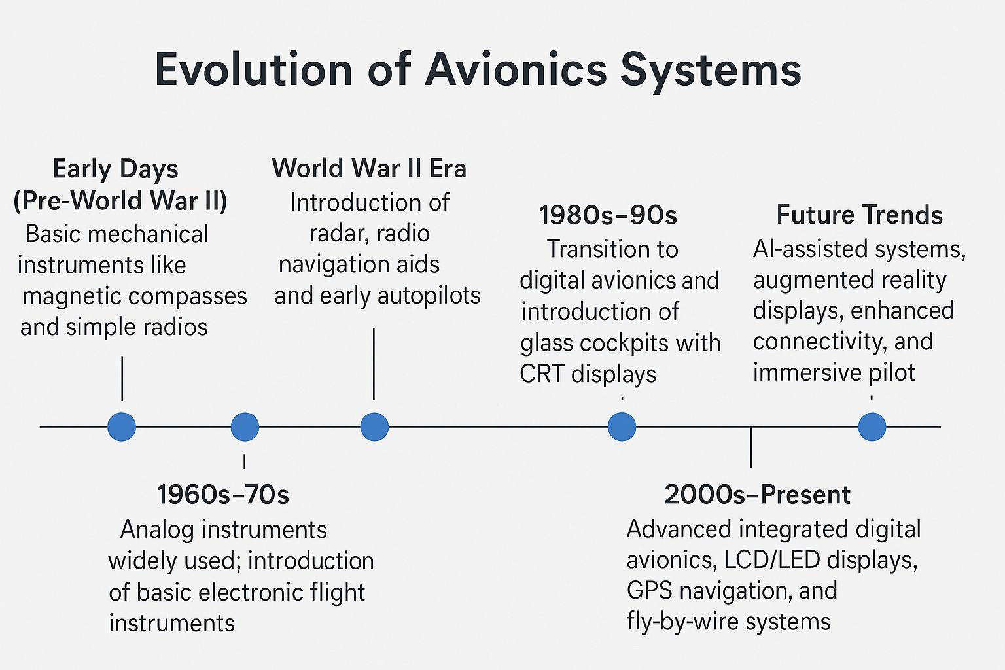
Evolution of Avionics Systems

Slide 35
Categories of Avionics
Navigation Systems
Communication Systems
Flight Control Systems
Monitoring Systems
Weather Systems
Collision Avoidance Systems

Slide 36
Cockpit Layout
Primary Flight Display (PFD): Shows attitude, airspeed, altitude, heading
Multi-Function Display (MFD): Navigation, weather, systems status
Flight Management System (FMS): Automates navigation and flight planning
Autopilot Control Panel: Controls automated flight modes
Communication Radios: VHF/UHF radios for air-to-ground and air-to-air comms
Transponder: Sends aircraft ID and altitude to radar
Engine Instruments Display: Monitors engine performance and parameters

Slide 37
Flight Management System (FMS)
The FMS is an advanced onboard computer system that automates and optimizes flight planning, navigation, and aircraft performance management.
Key Functions:
Flight Planning: Creates and manages the flight route based on waypoints, airways, and arrival procedures.
Navigation: Integrates inputs from GPS, inertial navigation systems, and other sensors to guide the aircraft along the planned route.
Performance Management: Calculates optimum speeds, altitudes, and fuel consumption for efficient flight.
Guidance and Control: Provides commands to the autopilot and flight director for precise aircraft control.
Data Interface: Communicates with other avionics systems such as radios, autopilot, and displays.
Benefits:
Reduces pilot workload
Enhances flight safety and accuracy
Improves fuel efficiency
Enables complex route management and automatic rerouting

Slide 38

Global Positioning System (GPS)
GPS is a satellite-based navigation system that provides precise position, velocity, and time information to aircraft anywhere on Earth.
How It Works:
Uses a constellation of at least 24 satellites orbiting the Earth.
The aircraft’s GPS receiver calculates its location by measuring the time it takes signals from multiple satellites to reach the receiver.
Provides continuous, real-time position updates.
Role in Avionics:
Enables accurate navigation and route tracking.
Supports approach, landing, and en-route operations.
Integrates with the Flight Management System (FMS) for optimized flight paths.
Enhances situational awareness and safety.
Benefits:
Global coverage, available anywhere 24/7.
High accuracy and reliability.
Reduces dependence on ground-based navigation aids.

Slide 39

Inertial Navigation System (INS)
An INS is a self-contained navigation system that uses motion sensors and gyroscopes to calculate an aircraft’s position, velocity, and orientation without external references.
How It Works:
Uses accelerometers to measure changes in velocity along different axes.
Uses gyroscopes to detect changes in aircraft attitude (pitch, roll, yaw).
Continuously integrates acceleration and rotation data to update position and velocity from a known starting point.
Role in Avionics:
Provides navigation data when GPS signals are unavailable or degraded.
Works independently of external signals, enhancing reliability.
Often combined with GPS for improved accuracy (called an integrated INS/GPS system).
Benefits:
Immune to jamming or signal loss.
Provides continuous, real-time navigation information.
Critical for long-haul flights over oceans or remote areas.

Slide 40
Attitude & Heading Reference System
AHRS is an integrated system of sensors that provides real-time aircraft attitude (pitch, roll) and heading information to the avionics.
How It Works:
Uses a combination of gyroscopes, accelerometers, and magnetometers.
Gyroscopes measure angular velocity.
Accelerometers detect gravitational direction for pitch and roll.
Magnetometers provide heading by sensing the Earth’s magnetic field.
Combines sensor data with algorithms (sensor fusion) to deliver accurate, stable orientation and heading.
Role in Avionics:
Replaces traditional mechanical gyros with a solid-state system.
Supplies attitude and heading info to Primary Flight Displays (PFD) and autopilot systems.
Essential for flight control, navigation, and situational awareness.
Benefits:
Lightweight and reliable with no moving parts.
Faster start-up and better accuracy than older gyro systems.
Reduces pilot workload by providing stable and precise orientation data.

Slide 41
Autopilot Systems
Autopilot is an on-board automated system that controls the aircraft’s flight path, reducing pilot workload by managing flight control surfaces and navigation.
Key Functions:
Flight Path Control: Maintains heading, altitude, and speed as set by pilots or the Flight Management System (FMS).
Navigation Following: Flies predefined routes using inputs from navigation systems like GPS and INS.
Approach and Landing Assistance: Supports precision approaches and automatic landings in some aircraft.
Modes of Operation: Includes altitude hold, heading hold, vertical speed, and navigation tracking modes
Components:
Flight control computers
Actuators controlling ailerons, elevators, rudder, throttle
Sensors feeding attitude, airspeed, and altitude data
Pilot interface panel for mode selection and adjustments
Benefits:
Reduces pilot fatigue on long flights
Enhances flight precision and safety
Allows multi-tasking and better situational awareness

Slide 42

Electronic Flight Instrument System
EFIS is a digital flight instrument system that replaces traditional mechanical gauges with electronic displays, providing pilots with clear, integrated flight data.
Components:
Primary Flight Display (PFD): Shows attitude, airspeed, altitude, vertical speed, and heading.
Multi-Function Display (MFD): Displays navigation maps, weather, systems status, and other data.
Control Display Unit (CDU): Allows pilots to interact with the system and select display options.
Features:
Real-time, customizable flight data presentation
Integration of multiple sensors (GPS, INS, AHRS)
Enhanced situational awareness through clear graphics and alerts
Ability to display synthetic vision and terrain information
Benefits:
Improves pilot decision-making and safety
Reduces cockpit clutter by consolidating instruments
Easier to read and interpret under various lighting conditions

Slide 43
Primary Flight Display (PFD)
The PFD is a key digital cockpit display that presents essential flight information needed for aircraft control and situational awareness.
Key Information Displayed:
Attitude Indicator: Shows aircraft pitch and bank angles relative to the horizon.
Airspeed Tape: Displays current airspeed.
Altitude Tape: Shows aircraft altitude.
Heading Indicator: Displays current heading.
Vertical Speed Indicator: Shows climb or descent rate.
Flight Mode Annunciations: Displays autopilot and flight director modes.
Role in Avionics:
Centralizes critical flight data in one screen.
Helps pilots maintain aircraft control and orientation.
Interfaces with autopilot and flight management systems.
Benefits:
Improves situational awareness.
Reduces pilot workload by consolidating instruments.
Enhances safety, especially in low visibility conditions.

Slide 44
Multi-Function Display (MFD)
The MFD is a versatile cockpit display that provides pilots with a wide range of information beyond basic flight data, enhancing situational awareness and decision-making.
Key Functions:
Navigation Maps: Displays moving maps, waypoints, airways, and terrain.
Weather Radar: Shows weather conditions and storm activity along the route.
Systems Monitoring: Displays engine performance, fuel status, and aircraft systems health.
Traffic Information: Shows nearby air traffic alerts and collision avoidance data.
Flight Planning: Allows route editing and management in coordination with the Flight Management System (FMS).
Role in Avionics:
Complements the Primary Flight Display (PFD) by providing additional data.
Helps pilots monitor external environment and aircraft systems.
Improves flight safety and operational efficiency.
Benefits:
Consolidates multiple data types in one display.
Enhances pilot situational awareness and workload management.
Customizable to show relevant information based on flight phase.

Slide 45
Weather Radar Systems
Weather radar systems use radio waves to detect and display weather conditions such as precipitation, turbulence, and storm activity ahead of the aircraft.
How It Works:
Sends out radio waves that bounce off precipitation particles (rain, snow, hail).
Measures the returned signals to determine intensity, location, and movement of weather.
Displays weather patterns on cockpit screens, often on the Multi-Function Display (MFD).
Role in Avionics:
Provides real-time weather information to pilots.
Helps in route planning and avoiding hazardous weather.
Enhances flight safety by warning of turbulence and storms.
Benefits:
Improves situational awareness in adverse weather.
Allows proactive decision-making to avoid dangerous weather.
Reduces risk of turbulence and icing encounters.

Slide 46

Terrain Awareness System
TAWS is an onboard safety system that alerts pilots about potential collisions with terrain or obstacles by using a digital terrain database and the aircraft’s position.
How It Works:
Uses GPS and navigation data to determine the aircraft’s precise location and trajectory.
Compares aircraft position with a detailed terrain and obstacle database.
Provides visual and audible alerts if the aircraft is at risk of flying too close to the ground or obstacles.
Role in Avionics:
Enhances situational awareness of surrounding terrain.
Prevents Controlled Flight Into Terrain (CFIT) accidents.
Often integrated into cockpit displays, like the Multi-Function Display (MFD).
Benefits:
Improves flight safety, especially in poor visibility or unfamiliar areas.
Helps pilots make timely course corrections to avoid terrain.
Reduces accident risk during approach, landing, and low-altitude flight.

Slide 47
Traffic Collision Avoidance System
TCAS is an onboard system designed to reduce the risk of mid-air collisions between aircraft by monitoring the airspace around them.
How It Works:
Detects nearby aircraft via transponder signals.
Analyzes potential collision threats.
Issues alerts and resolution advisories (climb, descend, or maintain altitude).
Key Features:
Provides pilots with timely warnings.
Helps maintain safe separation.
Works independently of ground radar.
Benefits:
Enhances flight safety.
Reduces risk of mid-air collisions.
Used globally in commercial aviation.

Slide 48
Radio Communication Systems
Systems that use radio waves to transmit and receive information wirelessly over distances.
Components:
Transmitter
Receiver
Antenna
Frequency/channel
Types:
Two-way radios (e.g., walkie-talkies)
Broadcast radios (AM/FM)
Satellite radios
Applications:
Aviation and marine communication
Emergency services
Broadcasting and media
Mobile and wireless networks
Advantages:
Enables long-distance communication
Supports mobile and remote connectivity
Quick and reliable information exchange

Slide 49

Transponders & ADS-B
Transponders:
Aircraft devices that transmit identification and altitude data when interrogated by radar.
Help Air Traffic Control (ATC) track and identify aircraft.
ADS-B (Automatic Dependent Surveillance-Broadcast):
Modern surveillance technology where aircraft broadcast their GPS position and other data automatically.
Provides real-time, accurate position info to ATC and nearby aircraft.
Differences:
Transponders respond to radar signals; ADS-B broadcasts continuously.
ADS-B offers better accuracy and situational awareness.
Benefits:
Improved air traffic safety and efficiency.
Enables better traffic collision avoidance.
Supports next-gen airspace management.

Slide 50
Data Buses and Architecture
Data Bus:
A communication system that transfers data between components inside a computer or electronic system.
Purpose:
Connects sensors, processors, and actuators for efficient data exchange.
Common Types:
ARINC 429: Used in avionics for reliable, point-to-point data transfer.
MIL-STD-1553: Military standard for robust and redundant data communication.
CAN Bus: Controller Area Network used for real-time communication.
Architecture:
Defines how components are interconnected.
Can be serial or parallel.
May use bus, star, or ring topologies.
Importance:
Ensures synchronized and error-free data flow.
Critical for avionics and embedded system performance.

Slide 51
Flight Data & Cockpit Voice Recorders
Flight Data Recorder (FDR):
Records aircraft performance data like speed, altitude, heading, and system status.
Helps investigate accidents and improve safety.
Cockpit Voice Recorder (CVR):
Records cockpit audio, including pilot conversations and ambient sounds.
Provides insight into crew actions and communication during flights.
Key Features:
Both devices are crash-resistant and designed to survive extreme conditions.
Typically located in the aircraft tail section.
Purpose:
Aid accident investigations.
Enhance training and safety protocols.

Slide 52
Heads-Up Display (HUD)
A transparent display that presents critical flight information directly in the pilot’s line of sight.
Key Features:
Projects data such as speed, altitude, heading, and navigation cues.
Allows pilots to keep their eyes outside the cockpit while monitoring instruments.
Benefits:
Enhances situational awareness.
Reduces pilot workload and reaction time.
Improves safety during takeoff, landing, and low-visibility conditions.
Applications:
Used in military and commercial aircraft.
Also adapted for automotive and other industries.

Slide 53

Synthetic Vision Systems (SVS)
SVS is a computer-generated 3D visualization of the terrain and environment displayed to pilots.
How It Works:
Uses GPS, terrain databases, and aircraft sensors.
Provides a clear virtual view of surroundings, regardless of weather or visibility.
Key Features:
Displays terrain, obstacles, runways, and navigation data.
Enhances situational awareness, especially in poor visibility.
Integrates with primary flight displays or HUDs.
Benefits:
Improves flight safety by reducing spatial disorientation.
Assists in safer approaches and landings.
Supports pilot decision-making in challenging conditions.

Slide 54
Satellite Communication (SATCOM)
Communication system that uses satellites to relay signals between ground stations and aircraft or ships.
How It Works:
Signals transmitted from a terminal to a satellite in orbit.
Satellite forwards the signal to the receiving station.
Key Features:
Provides global coverage, including remote and oceanic areas.
Supports voice, data, and internet communications.
Enables real-time tracking and weather updates.
Benefits:
Ensures continuous communication beyond line-of-sight limits.
Enhances safety and operational efficiency.
Vital for modern aviation, maritime, and defense sectors.

Slide 55
Autonomous Systems in Avionics
Systems capable of performing flight operations with minimal or no human intervention using advanced sensors and algorithms.
Key Components:
Autopilot and flight management systems
Sensors (e.g., radar, lidar, GPS)
Artificial Intelligence and machine learning
Functions:
Navigation and route optimization
Collision avoidance
Automated take off, cruise, and landing procedures
Improves flight safety and reliability
Reduces pilot workload and human error
Enables future concepts like unmanned aerial vehicles (UAVs) and urban air mobility
Benefits:

Slide 56
Avionics Software Updates
To enhance system functionality, fix bugs, improve security, and comply with regulatory requirements.
Update Types:
Routine Maintenance: Minor fixes and performance improvements
Major Upgrades: New features and system enhancements
Security Patches: Address vulnerabilities
Process:
Software validation and certification
Upload via ground stations or onboard networks
Verification through testing and flight checks
Challenges:
Ensuring safety and reliability during updates
Managing complex certification processes
Minimizing downtime for aircraft
Benefits:
Keeps avionics systems current and efficient
Enhances operational safety and compliance

Slide 57
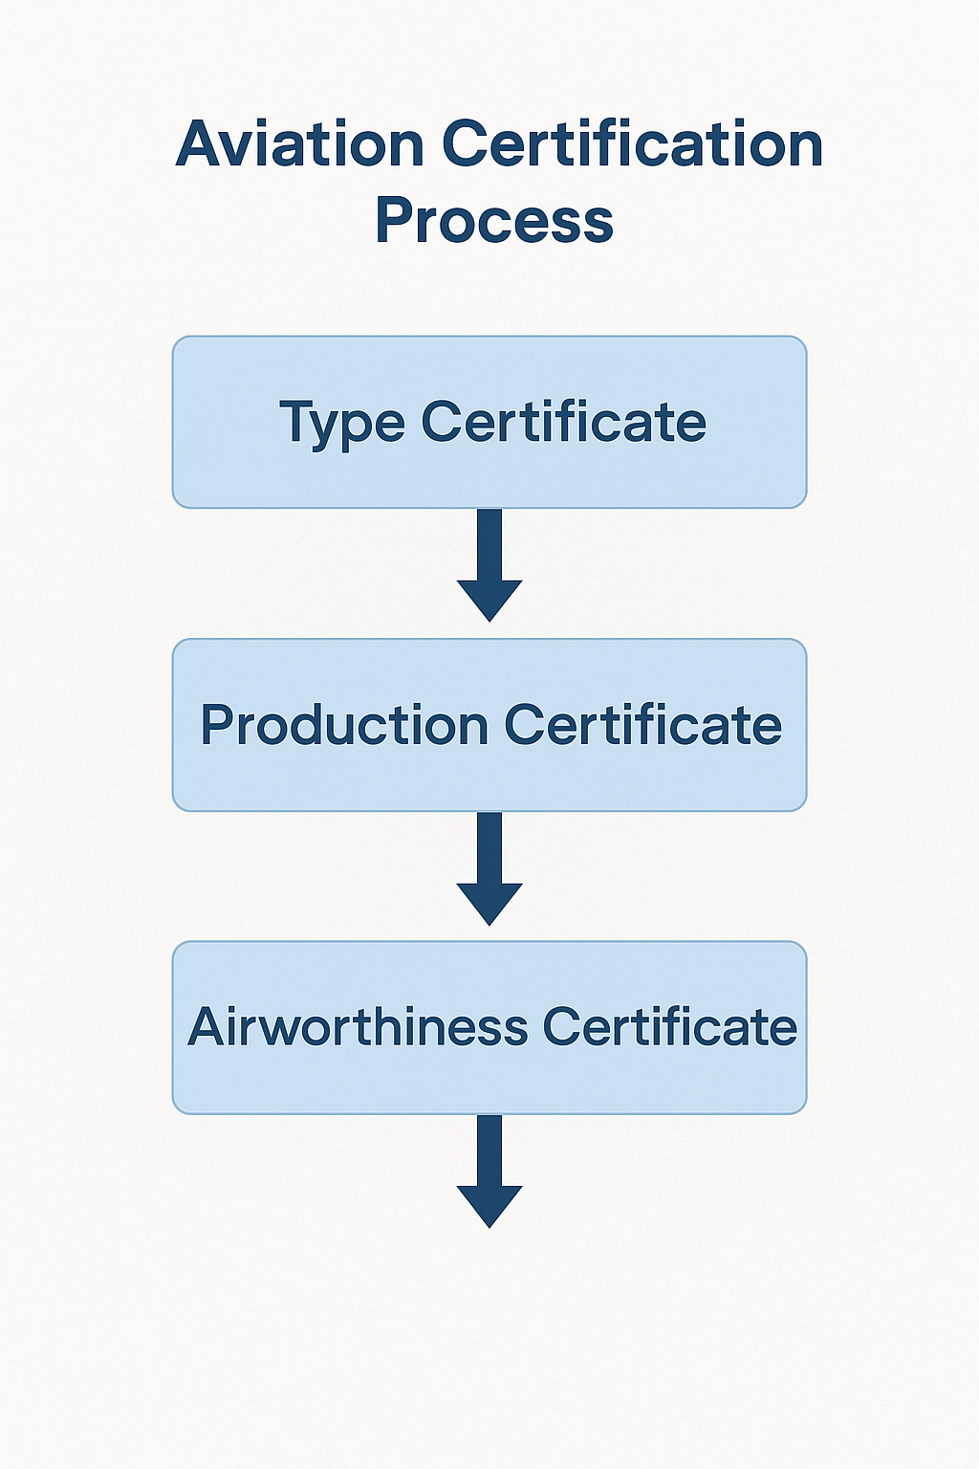
Certification & Standards
Ensure safety, reliability, and interoperability of aircraft and avionics systems.
Key Organizations:
FAA (Federal Aviation Administration) – U.S. regulatory body
EASA (European Union Aviation Safety Agency) – Europe
ICAO (International Civil Aviation Organization) – Global standards
Types of Certification:
Type Certification: Approval of aircraft design
Production Certification: Ensures manufacturing consistency
Airworthiness Certification: Confirms aircraft is safe to operate
Standards:
Define design, testing, and maintenance requirements
Examples: DO-178C (software), DO-254 (hardware), ARINC standards
Importance:
Guarantees compliance with safety regulations
Facilitates international operations and trust

Slide 58
UAV Avionics
Electronic systems onboard UAVs enabling navigation, control, communication, and mission execution.
Key Components:
Flight Control System (Autopilot, IMU)
Navigation (GPS, INS)
Communication (RF, telemetry)
Payload Control (cameras, sensors)
Power Management
Health Monitoring
Functions:
Autonomous flight control (takeoff, navigation, landing)
Real-time data transmission
Mission planning and execution

Slide 59
Cybersecurity in Avionics
Protects aircraft electronic systems from cyber threats that can compromise safety and mission integrity.
Key Risks:
Unauthorized access to flight control systems
Data interception and manipulation
GPS spoofing and jamming
Malware and ransomware attacks
Security Measures:
Encryption of communication links
Secure authentication and access controls
Intrusion detection and prevention systems (IDPS)
Regular software updates and patch management
Redundancy and fail-safe mechanisms
Goal: Ensure confidentiality, integrity, and availability of avionics systems to maintain safe and reliable flight operations.

Slide 60
Future Trends in Avionics
Artificial Intelligence & Machine Learning Enhanced autopilot, predictive maintenance, and adaptive flight control.
Integrated Modular Avionics (IMA) Flexible, scalable architectures reducing weight and cost.
Cybersecurity Enhancements Advanced threat detection, blockchain for secure communication.
Enhanced Connectivity 5G and satellite networks for real-time data and global coverage.
Electric & Hybrid Propulsion Integration Avionics adapted for new powertrain technologies.
Augmented Reality (AR) & Virtual Reality (VR) Pilot assistance and training tools for improved situational awareness.

Slide 61
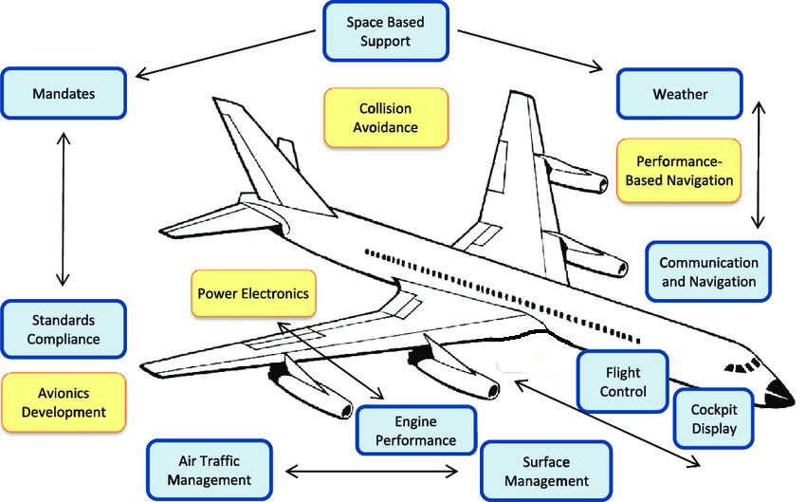
Summary of avionics techniques

Slide 62

Review
Overview of UAV Avionics components and functions
Importance of Cybersecurity in protecting avionics systems
Emerging Future Trends shaping avionics technology

Slide 63


